Slide 1
Mbot Turning Basics

Slide 2
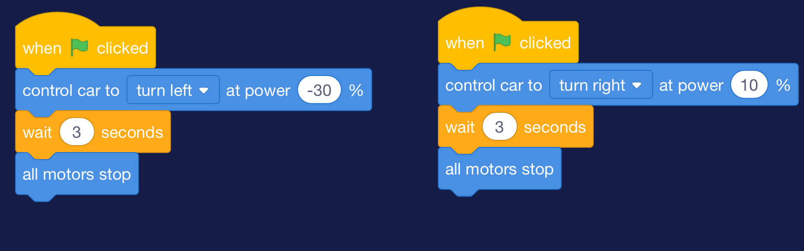
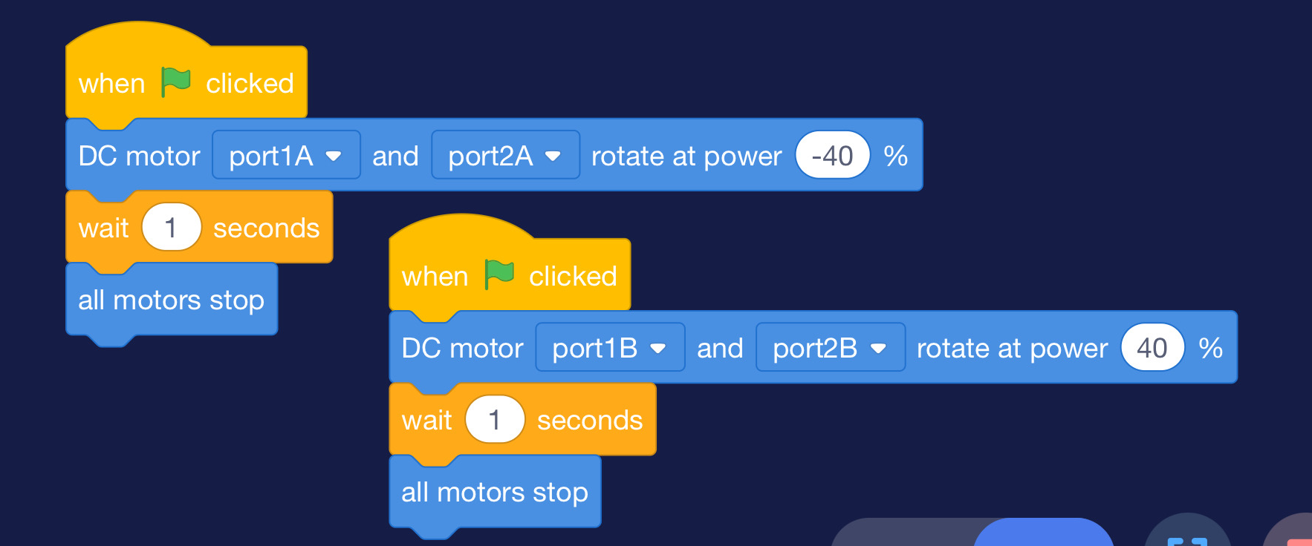
What’s wrong with this code?
Picture #1
Picture #2

Slide 3

Start/Go
What it does:
It gives the command to run/start your code
Without it, Your code will not run!
Can only use once
Goes at the very start

Slide 4

Wait x seconds
This code block makes mbot run for x seconds
Ex: 16 seconds means the mbot command block before it runs for 16 seconds
Can be used multiple times

Slide 5

All motors stop
Ends the full code
Can only use once
Goes at the very end

Slide 6


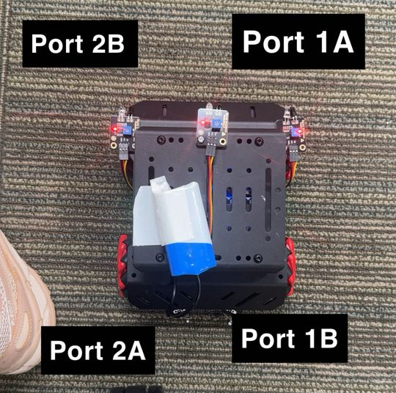
mBot Motors
Front of mBot
The mBot Mega’s motors work based on speed values
Positive values (+) → The motor moves forward.
Negative values (-) → The motor moves backward.
Zero (0) → The motor stops.
Back of mBot

Slide 7
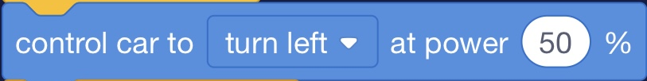
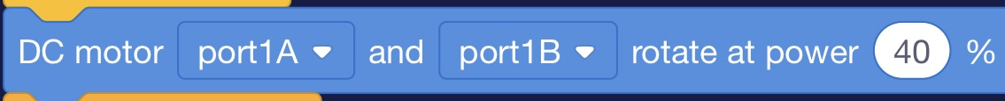
Control Turns
These blocks of code control the turns (Side to SIDE or LEFT and Right)
Select the direction or the motors & set the power
Lower percentage = less power
Higher percentage = more power
Can be used multiple times
Positive values (+) → The motor moves forward.
Negative values (-) → The motor moves backward.
Zero (0) → The motor stops.

Slide 9
Now you know the basics, lets test Your debugging skills!

